Slide 1
Lending Club Case Study
Submitted by:
Garvit Minocha (Group Facilitator)
Shivendu Sharma

Slide 2
Business Problem Statement
You work for a consumer finance company which specializes in lending various types of loans to urban customers. When the company receives a loan application, the company has to make a decision for loan approval based on the applicant’s profile. Two types of risks are associated with the bank’s decision:
If the applicant is likely to repay the loan, then not approving the loan results in a loss of Business to the company.
If the applicant is not likely to repay the loan, i.e. he/she is likely to default, then approving the loan may lead to a financial loss for the company
The data given below contains the information about past loan applicants and whether they ‘defaulted’ or not.
The aim is to identify patterns which indicate if a person is likely to default, which may be used for taking actions such as denying the loan, reducing the amount of loan, lending (to risky applicants) at a higher interest rate, etc.

Slide 3
Data Analysis Approach(step-by-step)
Like most other lending companies, lending loans to ‘risky’ applicants is the largest source of financial loss (called credit loss).
If one is able to identify these risky loan applicants, then such loans can be reduced thereby cutting down the amount of credit loss. Identification of such applicants using EDA is the aim of this case study.
Business & Problem statement understanding
Exploring & Formatting Data
Perform Multivariate Analysis
Summary & Suggestions
Perform Bivariate Analysis
Perform Univariate Analysis
Removing Outliers
Data Cleaning(datatype handling, missing values elimination, unnecessary columns elimination)

Slide 4
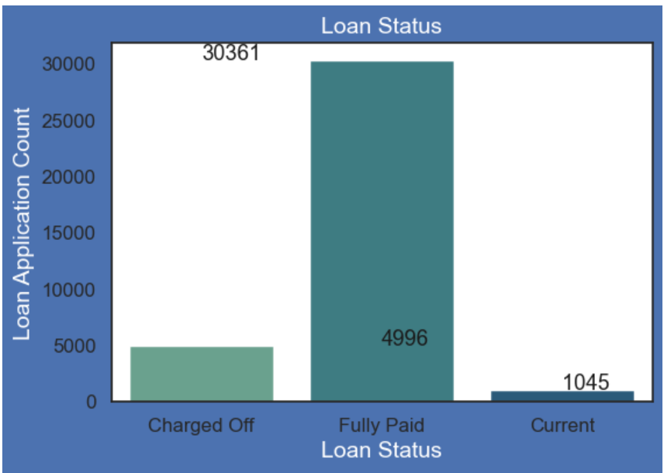
Loan Status vs Loan Count
Plot and Data shows that :
14% loans were charged off out of total loans issued.
83% loans were fully paid out of total loan issued.
Fully Paid 82.96 %
Charged Off 14.17 %
Current 02.87 %

Slide 5
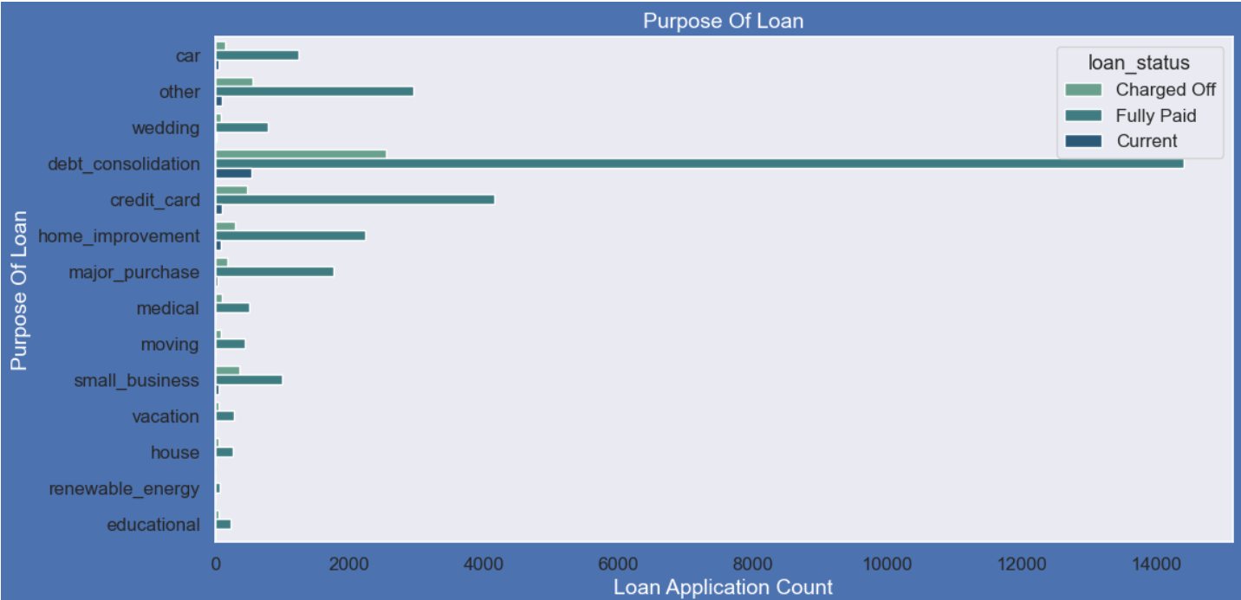
Purpose of Loan vs Loan Application Count
Purpose of Loans:
Most of the loans were taken for the purpose of Debt consolidation & paying Credit card bill.
Number of charged off count appears to be high for these loans as well.
Loan Purpose Percentage:
debt_consolidation 46.93%
credit_card 12.92%
other 10.05%
home_improvement 7.49%
major_purchase 5.51%
small_business 4.60%

Slide 6
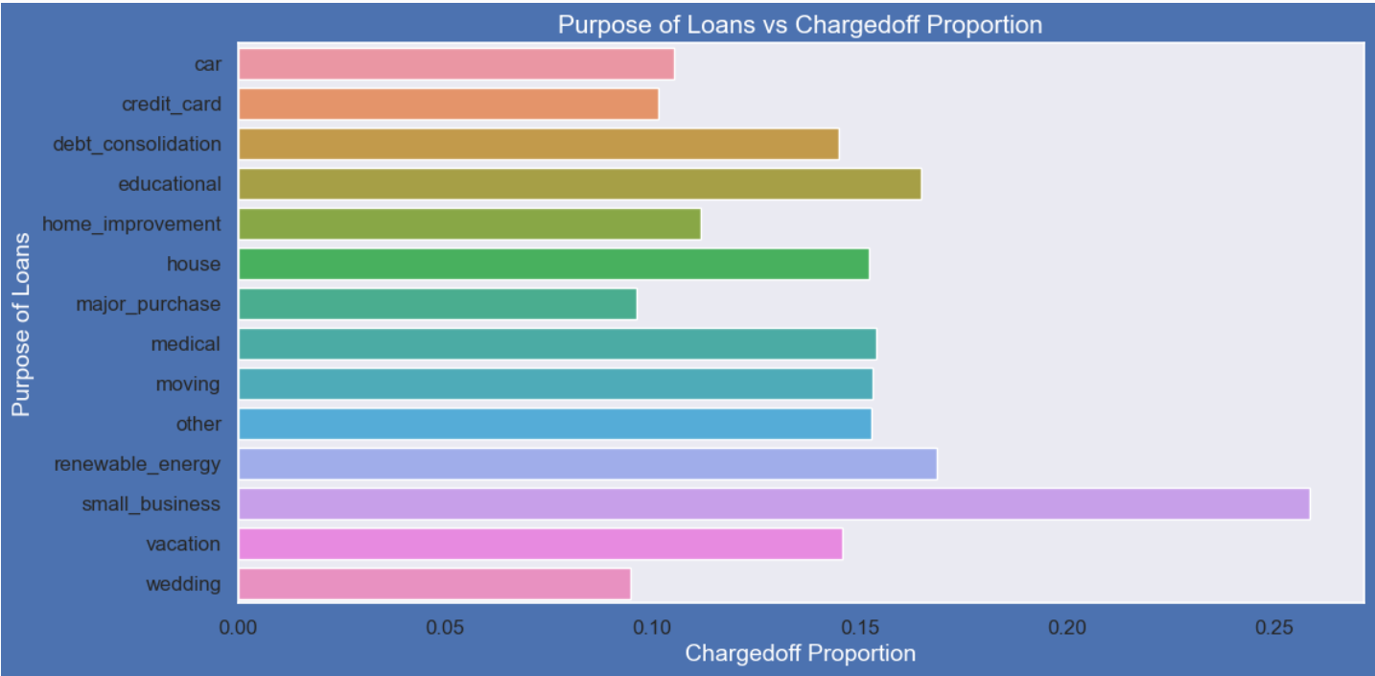
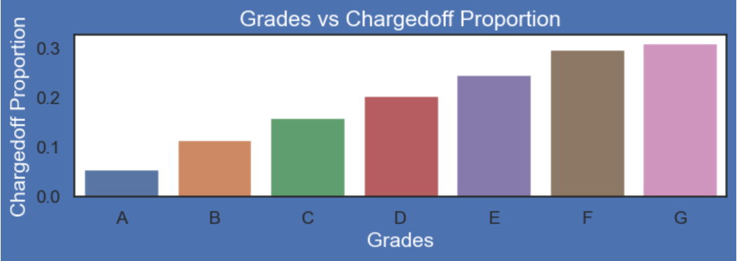
Loan Purpose & Grades vs Charged-Off Proportion
Purpose of Loans v/s Loan charged off Proportion :
Applicants with loan purpose as "small Business" have high chances of getting charged off.
Renewable energy purpose is where charged off proportion is better as compared to other categories.
Grades v/s Loan charged off Proportion:
Grade "A" has very less chances of charged off.
Grade "F" and "G" have very high chances of charged off.
Chances of charged of is increasing with grade moving from "A" towards "G"

Slide 7
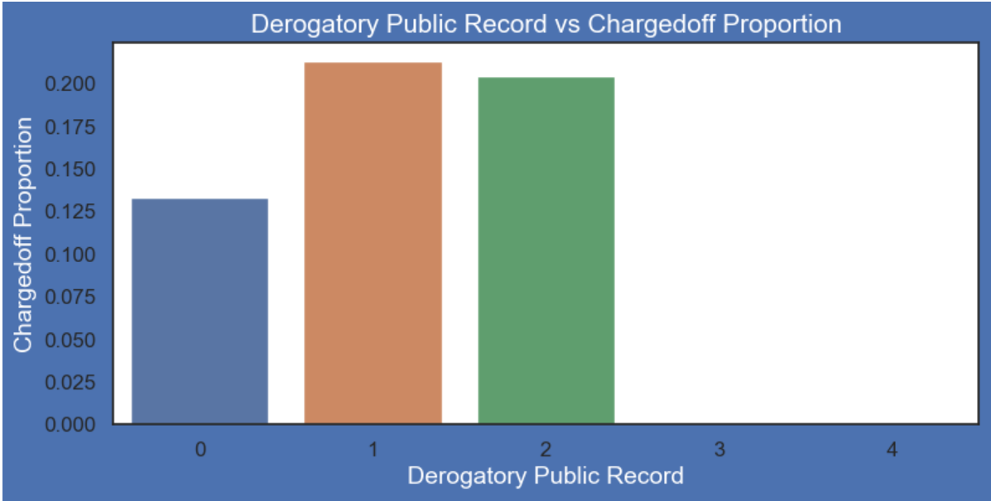
Derogatory Public records vs Charged-Off Proportion
Derogatory Record v/s Loan charged off Proportion :
A derogatory item is an entry that may be considered negative by lenders because it indicates risk and hurts your ability to qualify for credit or other services(eg: Cibil score).
Those who already have Derogatory Public Record value as 1 or 2 have higher charged off chances than others.

Slide 8
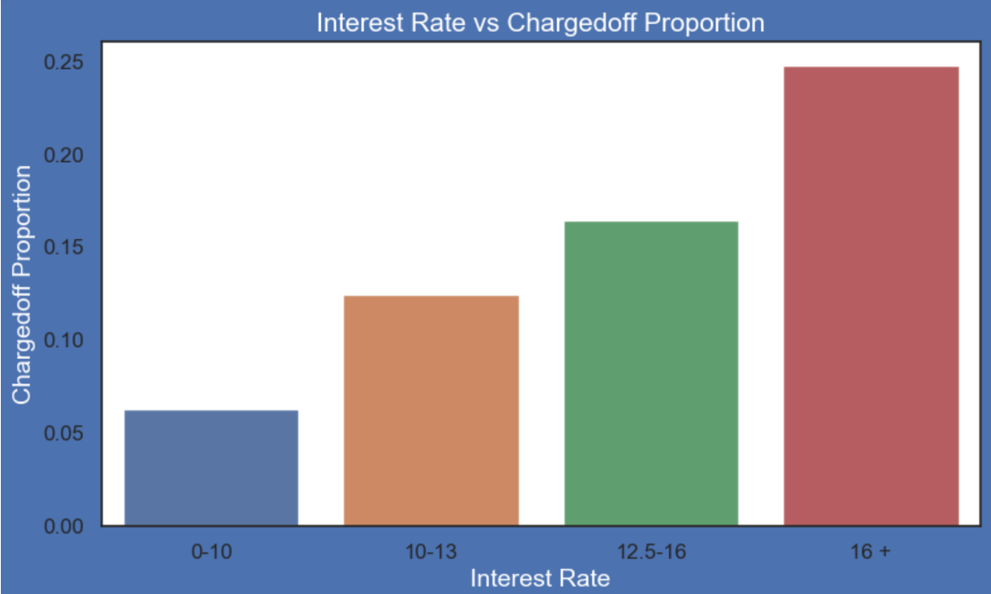
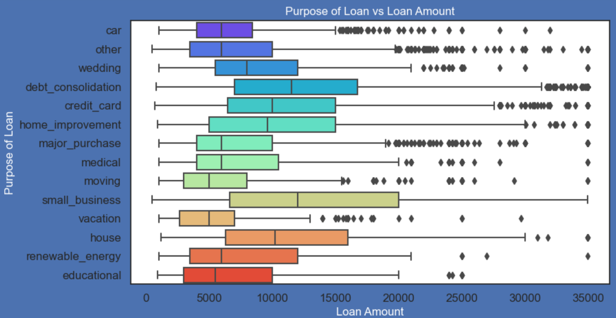
Charged-Off Proportion Analysis
Int rates Vs charged off Proportion :
Applicants with loan interest rate of more than 16% have good chances of being charged off as compared to other category's interest rates.
Charged off proportion and interest rates are directly proportional or have a positive correlation.
Purpose of Loan v/s Amount applied for Loan:
Most of the loan amounts are big for small business purpose among all purposes.
While the Debt consolidation is second and Credit card is third.

Slide 9
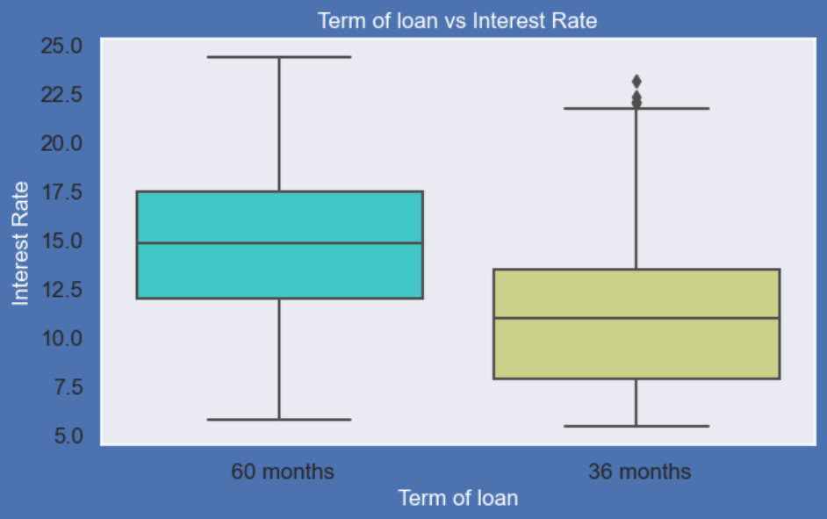
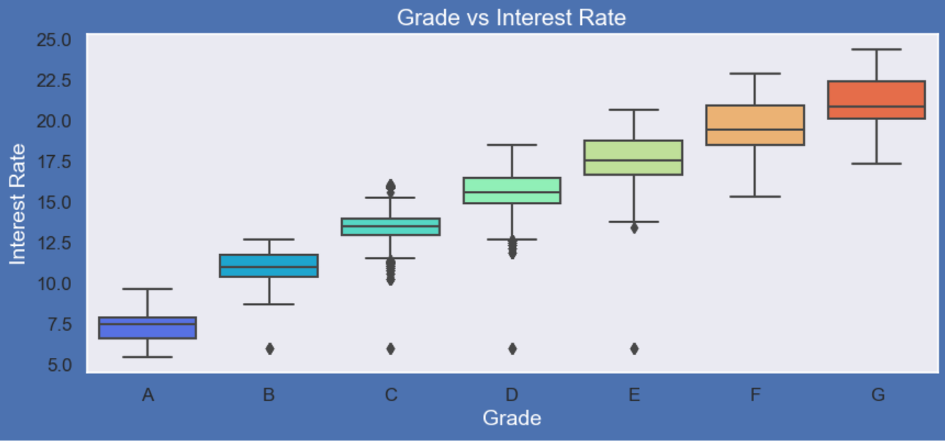
Interest Rate Analysis
Grades v/s Interest Rate:
A-grade is a top letter grade for a lender to assign to a borrower.
The higher the borrower's credit grade, the lower the interest rate offered to that borrower on a loan.
It is clear that interest rate is increasing with grades moving from A to F.
Term of Loan v/s Interest Rate:
It is clear that average interest rate is higher for 60 months(5 years) loan term.
Most of the loans issued for longer term had higher interest rates for repayment(positive correlation).

Slide 10
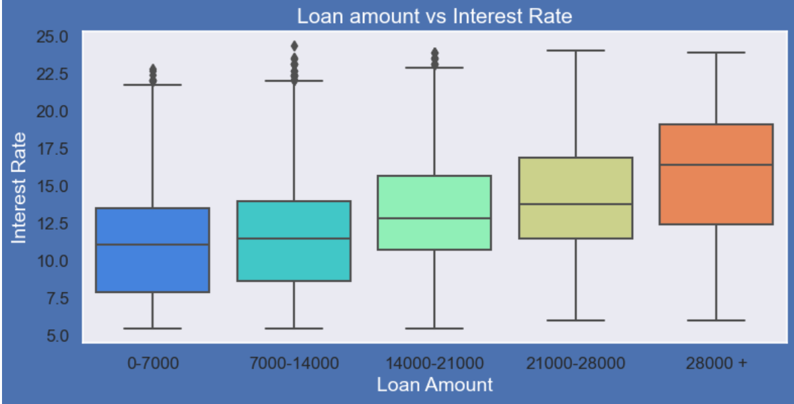
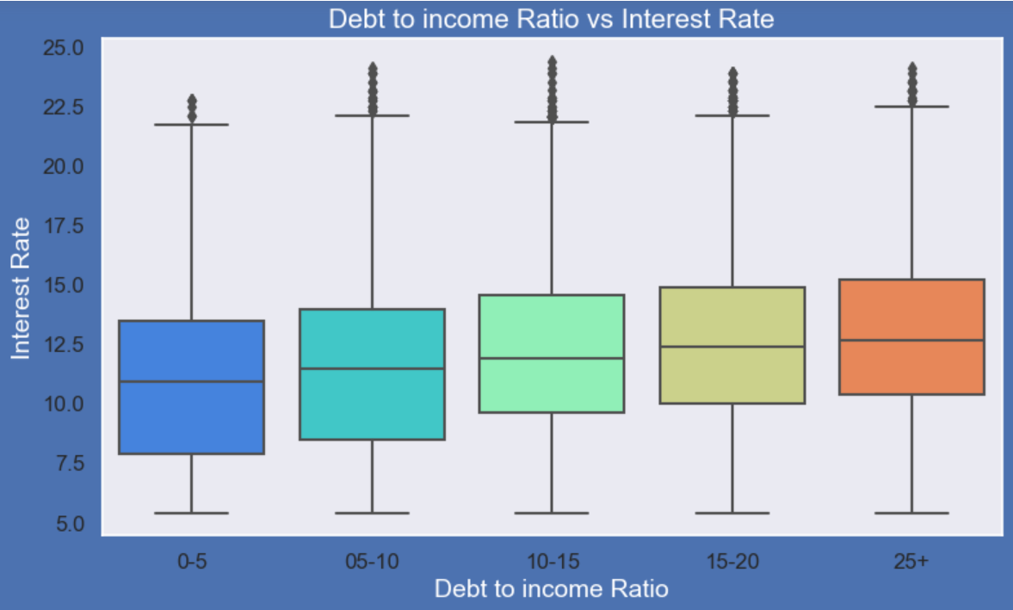
Interest Rate Analysis
Loan Amount v/s Interest Rate:
It is clear that interest rate is increasing with loan amount increase(positive correlation).
probably when loan amount is more it is taken for longer loan term, we saw earlier that longer the loan term more the interest rate(positive correlation).
Debt to Income (DTI) v/s Interest Rate:
If your DTI is low enough you may get a lower interest rate.
Plot shows no significant variation but there is a slight increase in interest rate with increase in DTI(positive correlation).

Slide 11
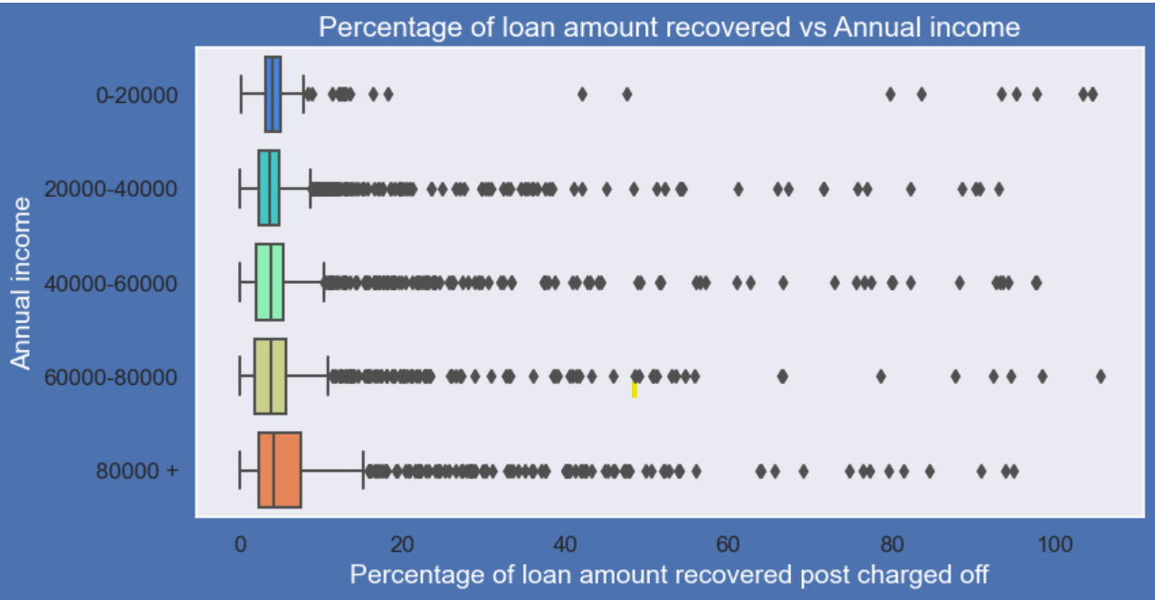
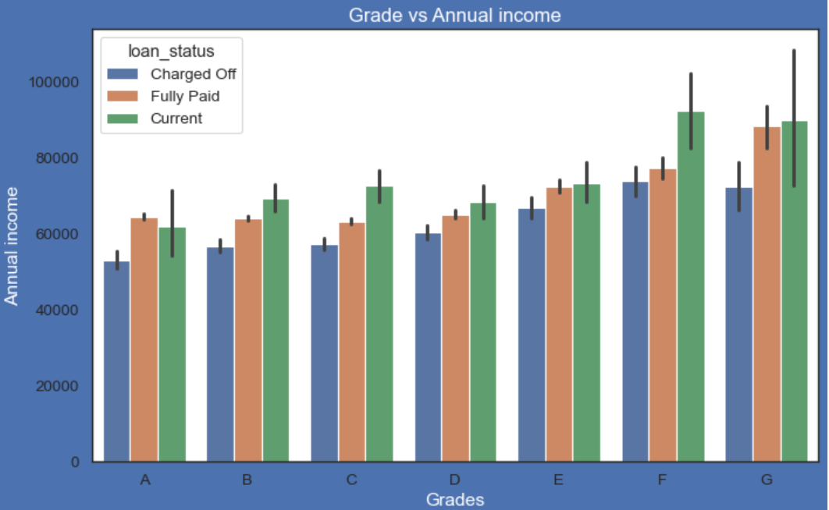
Annual Income Analysis
Loan Amount Recovered v/s Annual Income:
Higher percentage of loan amount is recovered when annual income is high.
Plot shows no significant variation but there is slight increase in recovery percentage with increase in annual income.
Grade v/s Applicant’s Annual Income:
From this we can conclude that the ones getting charged off for delayed or no repayment of loan have lower annual incomes than the ones who have fully paid for each and every grade (i.e. at same interest range).

Slide 12
Summary & Suggestions
Below is a summary of conclusions done on the basis of dataset variables:
Small Business Applicants have higher chances of getting charged off.
Charged off proportion increases with grades moving from “A” towards “G”(high chances of default in F&G categories).
Charged off proportion increases as Interest Rate Increases.
Higher the public bankruptcy record greater the charged-off proportion.
The loan amounts are bigger on average for small business purpose among all purposes of Loan.
Those who already have Derogatory Public Records have higher chances of charged off than others.
Average interest rate is considerably higher for 60 months loan term than 36 months.
The ones getting charged off have lower annual incomes than the ones who have fully paid the loans liability for each and every grade

Slide 13
Suggestions to Lending Club
Suggestions or check points for identifying possible Defaulters
Loans for Small Business(Loan Purpose) Applicants should be checked properly.
Loan approval should be avoided for those who already have Derogatory Public Records.
Loan approval should be avoided for those who already have Public Bankruptcy Records.
Loan approval for Low quality loans should be avoided or given for smaller loan repayment term.
Lower annual income applicants should be avoided for big loan amounts with higher interest Rates.
Loan approval should be avoided for applicants who don’t have a source of income or adequate income against the loan amount applied for.
Loan approved for people who wish to have a long repayment term should be scrutinized from time to time as long repay term also indicates applicant’s inclination to have EMIs of lower amount or some kind of collateral should be kept in such cases.
Loans with high amount should be avoided for applicants who don’t have significant work experience as it affects their compensation, eventually impacting their liability to lender.

